Slide 1
MATLAB for Scientists Lecture 9: Independent final project

Slide 2
Project overview
Assignment specifics
MATLAB commands that you’ll need

Slide 3
Project overview
Image analysis is computationally challenging:
It encompasses every aspect of the objective techniques we’ve learned so far:
Matrix manipulation
Indexing
Using user-defined functions and built-in functions
If statements and for loops
Statistical testing and regressions
It also requires thoughtful, critical, and often subjective decision-making
There is no one pipeline that is correct
There are many ways to define objects of interest
It is up to the programmer to make fair decisions that can be justified and rigorously explained
It is up to the programmer to decide how to organize the code and scripts
One algorithm should be applicable to multiple datasets – you can only hard-code to the extent that it works on everything with equal validity

Slide 4
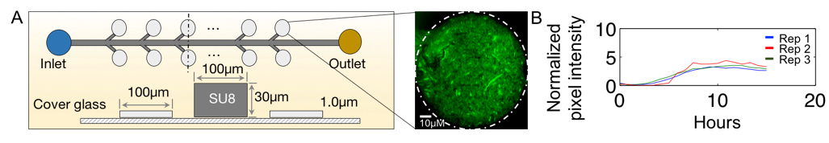
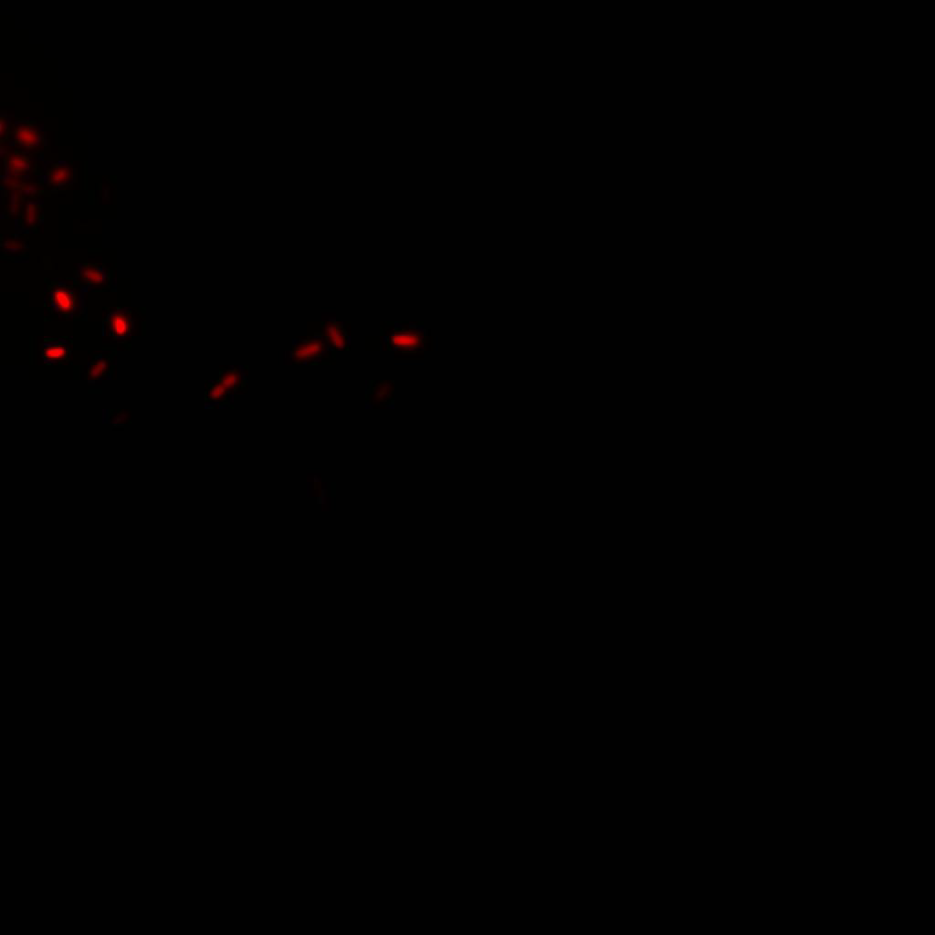
Experimental dataset
Sample video:
Experiment # | File number extensions | Strain
1 | Exp1rep1.dv, Exp1rep1.avi Exp1rep2.dv, Exp1rep2.avi Exp1rep3.dv, Exp1rep3.avi | G
2 | Exp2rep1, Exp2rep2, Exp2rep3 (.dv & .avi) | G
3 | Exp3rep1, Exp3rep2, Exp3rep3 (.dv & .avi) | R
4 | Exp4rep1, Exp4rep2, Exp4rep3 (.dv & .avi) | R
5 | Exp5rep1, Exp5rep2, Exp5rep3 (.dv & .avi) | R
6 | Exp6rep1, Exp6rep2, Exp6rep3 (.dv & .avi) | R
7 | Exp7rep1, Exp7rep2, Exp7rep3 (.dv & .avi) | G
8 | Exp8rep1, Exp8rep2, Exp8rep3 (.dv & .avi) | G
Eight separate experiments were conducted, each testing a different condition that either promoted, inhibited, or did not affect bacterial growth in a microfluidicchamber; we don’t know which is which. Three replicates were collected per experiment. Each experiment used one of two cell strains: G or R. G expresses green fluorescent protein (GFP), and R expresses red fluorescent protein (RFP), but are otherwise identical. Time-lapse images were taken at intervals of five minutes for at least 12 hours in all cases, although the total duration differed per experiment.

Slide 5
Overall project goal
The goal of this project is to determine whether you can confidently accept or reject the null hypothesis that bacterial growth is not statistically different between two experiments that will be randomly assigned to you.
Part 1: This is your (last!) HW#8 where you will answer a series of questions designed to help you develop a scaffold code for the final project
Outcome: HW#8 is submitted normally and is not included in the final report.
Part 2: This is your final project where you will develop a rigorous image analysis pipeline to analyze a real experimental dataset
Outcome: final report, MATLAB code, and oral presentation

Slide 6
Part 2 continued
Task: Develop one image analysis pipeline that fairly processes data from multiple independent experiments despite the batch to batch and day to day variability that may occur
Construct a rigorous image analysis pipeline that does the following:
Defines a metric for cells in the chamber, and plots a time course of cells (y-axis) vs. hours (x-axis). Examples include total fluorescence intensity, average intensity inside of the chamber, sum of all pixels above some threshold, etc.
Calculates growth rate from each time course. This metric can be defined in many ways, several of which we learned in class; you are free to choose whichever metric you want, but it must have units of cells hr⁻¹, where the units of cells depends on your definition from (a)(ex: pixels per hr)
Determines whether the average growth rate is statistically different between the two experiments.
Write a report that meets the guidelines described in the assignment document.

Slide 7
Components of Part 2 (see assignment for details)
Pre-analysis (due next week): Watch the videos you are assigned and write a short paragraph (< 300 words) that discusses a general framework for your analysis pipeline. Include any important considerations and challenges that you anticipate in order to ensure that one algorithm processes all videos are fairly.
Action | Points | Due date | Where to hand it in?
Pre-analysis | 5 | April 13th, 11:59p | Email
Written report: main text and .m files | 60 | April 28th, 12:59p | Courseworks
HW #8 | 16 | April 28th, 12:59p | Courseworks
Oral presentation | 35 | April 28th, 12:59p | Courseworks
Note: Points are included so you can see how I value each component, but will not be distributed unless specifically asked for

Slide 8
Video analysis
dvread (filename) | Use this to read in .dv files (dv are delta vision proprietary format)
uint8 | Convert images not of the class uint8 into uint8
implay | Plays .avi files in MATLAB
The folder DVfiles contains movie files in the format .dv and .avi.
.dv files are the raw dataset and should be used for MATLAB analysis.
.avi files are for visualization purposes only.

Slide 9
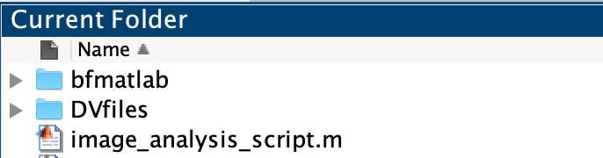
Folder structure
You should have the following two folders in the directory where you write your image analysis scripts/functions:
DVfiles: On google drive, this folder has all 24 .dv files and all 24 .avi files. On your local computer, only download the 6 files that are relevant to you (these files are large!) and store in a folder with the same name
Use .dv files for all MATLAB analysis (this is the raw data).
.avi files are for visualization purposes only.
bfmatlab: download this folder directly from bfmatlab

Slide 10
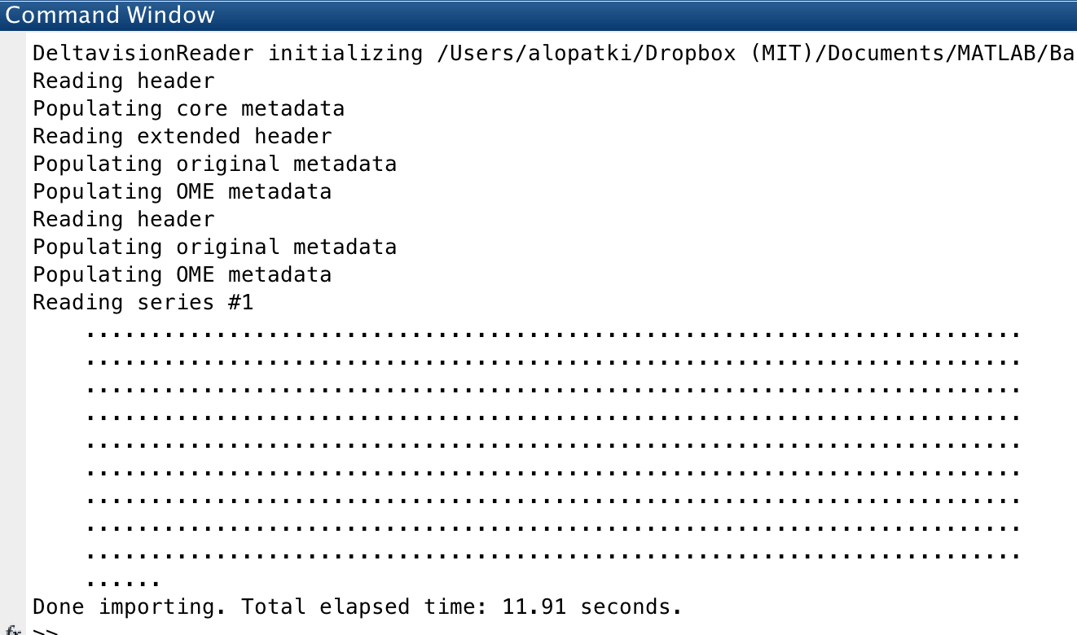
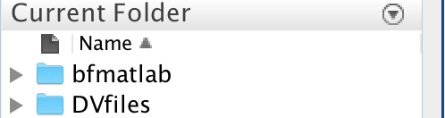
Importing .dv (delta vision) files
It will then load the video:
The folders DVfiles and bfmatlab must both be in your current directory:
addpath('DVfiles')
addpath('bfmatlab')
FileName = 'DVfiles/im7.dv’;
Images=dvread(FileName);

Slide 11
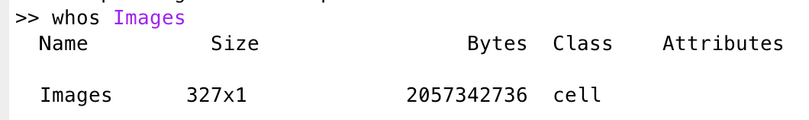
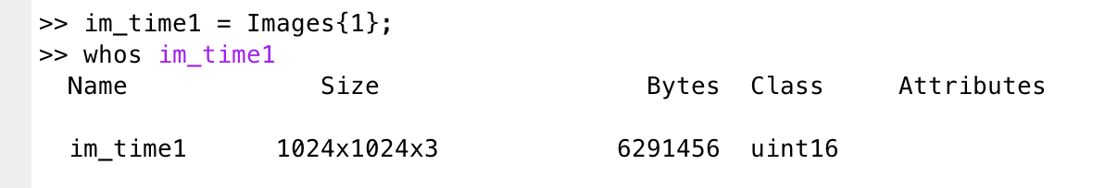
A video is a stored as cell array of images
The cell has 371 entries → this video has 327 time points
Use curly brackets to access cell arrays!!!
The first cell has one image that is uint16 class RGB matrix

Slide 12
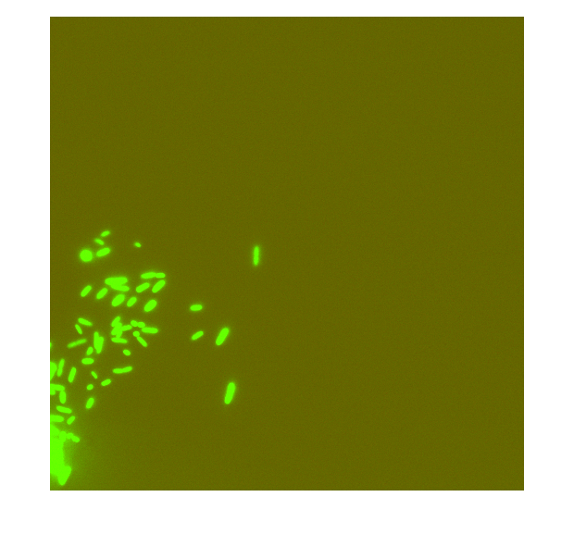
Never work in uint16 class!!!! ALWAYS convert to uint8
The range of double images is usually [0, 1], the range of 8-bit (uint8) intensity images is usually [0, 255], and the range of 16-bit (uint16) intensity images is usually [0, 65535].
To avoid conversion issues, stick with 8-bit only (uint8)
figure; imshow(im_time1)
figure; imshow(uint8(im_time1))

Slide 13
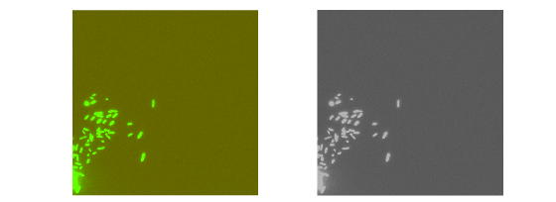
Go to the following link:
Download the entire folder bfmatlab
Download the video exp1rep1.dv and exp1rep1.avi and place in a folder called Dvfiles
Download lecture10_liveEx1.m and place in the directory immediately above these 2 folders. This is your template to use!
https://drive.google.com/open?id=1O51DQHu93j-XftS0t04mZ43RRY9zHZmb
Live example 1: practice reading in .dv files

Slide 14
Experiment assignments
Number | Experiments | Name
1 | 1 & 3
2 | 2 & 4
3 | 3 & 6
4 | 4 & 8
5 | 3 & 7
6 | 2 & 4
7 | 6 & 8
8 | 2 & 3
9 | 5 & 8
10 | 1 & 4
11 | 1 & 7
12 | 2 & 6
This will also define the order you’ll be presenting!

Slide 15
Final thoughts
Image analysis requires you to make decisions. There is no single correct algorithm. This is an opportunity for you to reflect on what we’ve learned, explore different methods, and gain a full appreciation for the art that is programming.
How do we make sure the choices we make don’t bias our results so that our conclusions are scientifically rigorous? Things to consider:
Are any steps specific to one dataset, or are they general?
What is the duration of the video?
Are all videos the same length?
How will this influence my analysis?
How is the overall video quality?
Does the quality stay consistent throughout the movie?
Do you need the entire time course to obtain the data?
What are the potential confounding variables between experiments, and how do I account for them?
Are different colors and different conditions equally comparable?
Is the chamber in the same location for every experiment?
Are there systematic differences between experiments that require normalization?

Slide 16
How do I begin?????
Start with HW8
Develop an algorithm to analyze one video
Put in for loop to analyze all videos → yay ! You have done enough to pass
Does it work? What is not great? How can you improve it? → refine code
Make the code look pretty – you’re a professional programmer now

